Slide 1

Quantum Key Distribution
Juan Lizarraga
Joan Mascaro
Timo Dolné

Slide 2



Introduction
How many roads must a man walk down before you call him a man?
5
Private
communication?
Alicia Keys
Bob Dylan

Slide 3
Table of Contents
Introduction to QKD: BB84 & E91
Classical improvements (repition code)
Exposing Eavesdroppers
Privacy Amplification

Slide 4

1
Introduction to BB84 & E91
A quick overview of the working principles of the protocols that perform QKD.
BB84 & E91
Repetition Code
Eavesdropper
Privacy Amplification

Slide 5
The basics of Quantum Key Distribution
Classical Channel
Alice
Bob
Quantum Channel
Chooses a basis (Z or H)
Chooses a bit
(0 or 1)
Chooses a basis
(Z or H)
BB84 & E91
Repetition Code
Eavesdropper
Privacy Amplification

Slide 6
The basics of Quantum Key Distribution
Classical Channel
Alice
Bob
Quantum Channel
Chooses a basis (Z or H)
Chooses a bit
(0 or 1)
Chooses a basis
(Z or H)
Comparing measurements
BB84 & E91
Repetition Code
Eavesdropper
Privacy Amplification

Slide 7
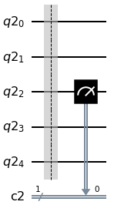
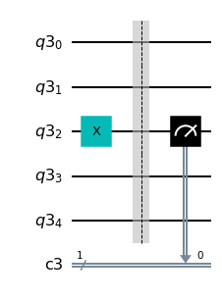
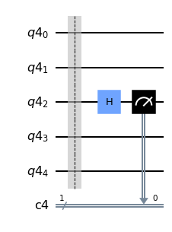
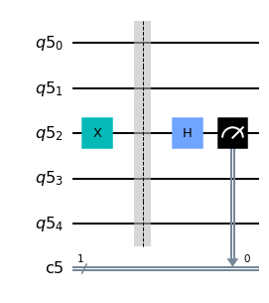
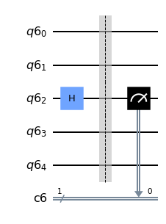
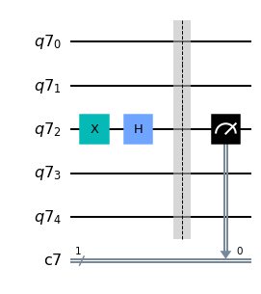
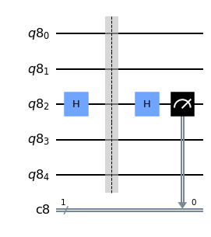
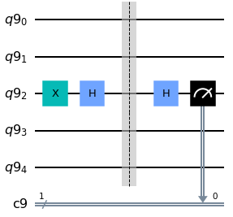
BB84 vs. E91
BB84 & E91
Repetition code
Eavesdropper
Privacy Amplification
Alice’s bit: 0
Alice’s basis: 0
Bob’s basis: 0
Alice’s bit: 1
Alice’s basis: 0
Bob’s basis: 0
Alice’s bit: 0
Alice’s basis: 0
Bob’s basis: 1
Alice’s bit: 1
Alice’s basis: 0
Bob’s basis: 1
Alice’s bit: 0
Alice’s basis: 1
Bob’s basis: 0
Alice’s bit: 1
Alice’s basis: 1
Bob’s basis: 0
Alice’s bit: 0
Alice’s basis: 1
Bob’s basis: 1
Alice’s bit: 1
Alice’s basis: 1
Bob’s basis: 1

Slide 8
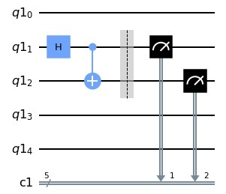
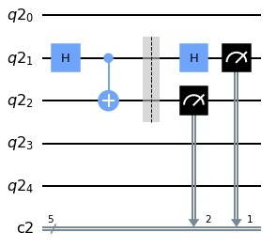
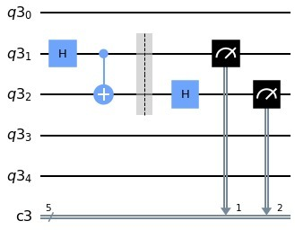
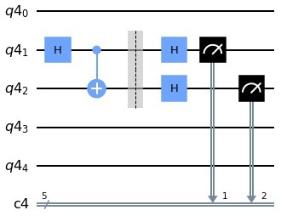
BB84 vs. E91
BB84 & E91
Repetition code
Eavesdropper
Privacy Amplification
Alice’s basis: 0
Bob’s basis: 0
Alice’s basis: 0
Bob’s basis: 1
Alice’s basis: 1
Bob’s basis: 0
Alice’s basis: 1
Bob’s basis: 1

Slide 9
The bigger picture
Measurements
Information reconciliation
Privacy Amplification
BB84 & E91
Repetition Code
Eavesdropper
Privacy Amplification

Slide 10
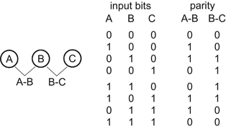
2
Repetition Code
Can we reduce Bob’s errors with a classical protocol
BB84 & E91
Repetition Code
Eavesdropper
Privacy Amplification

Slide 11
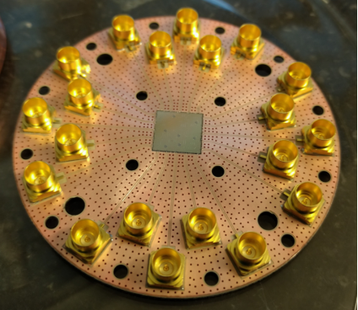
What are typical fidelities of the circuits?
BB84 & E91
Repetition code
Eavesdropper
Privacy Amplification
Qutech (2020)

Slide 12
Fidelities on BB84 circuits
BB84 & E91
Repetition code
Eavesdropper
Privacy Amplification
~ 99.3%
~ 96.0%
~ 98.6%
~ 94.5%
Alice’s bit: 0
Alice’s basis: 0
Bob’s basis: 0
Alice’s bit: 1
Alice’s basis: 0
Bob’s basis: 0
Alice’s bit: 0
Alice’s basis: 1
Bob’s basis: 1
Alice’s bit: 1
Alice’s basis: 1
Bob’s basis: 1
Qutech (2020)

Slide 13
How to decrease errors?
Alice’s Bits | 0 | 1 | 1 | 1 | 0 | 0 | 1 | 0 | 0 | 1 | 1 | 0 | 0 | 1 | 1 | 0 | …
Alice’s Basis | 1 | 0 | 0 | 0 | 0 | 1 | 0 | 1 | 1 | 0 | 1 | 0 | 0 | 1 | 0 | 1 | …
Bob’s Basis | 0 | 0 | 0 | 1 | 0 | 0 | 0 | 0 | 0 | 0 | 0 | 1 | 1 | 1 | 0 | 0 | …
Bob’s Bits (measured) | 0 | 1 | 1 | 0 | 0 | 0 | 0 | 1 | 1 | 1 | 0 | 1 | 0 | 0 | 1 | 1 | …
BB84 & E91
Repetition Code
Eavesdropper
Privacy Amplification

Slide 14
How to decrease errors?
Alice’s Bits | 0 | 1 | 1 | 1 | 0 | 0 | 1 | 0 | 0 | 1 | 1 | 0 | 0 | 1 | 1 | 0 | …
Alice’s Basis | 1 | 0 | 0 | 0 | 0 | 1 | 0 | 1 | 1 | 0 | 1 | 0 | 0 | 1 | 0 | 1 | …
Bob’s Basis | 0 | 0 | 0 | 1 | 0 | 0 | 0 | 0 | 0 | 0 | 0 | 1 | 1 | 1 | 0 | 0 | …
Bob’s Bits (measured) | 0 | 1 | 1 | 0 | 0 | 0 | 0 | 1 | 1 | 1 | 0 | 1 | 0 | 0 | 1 | 1 | …
?
?
Alice’s Bits | 0 | 1 | 1 | 1 | 0 | 0 | 1 | 0 | 0 | 1 | 1 | 0 | 0 | 1 | 1 | 0 | …
Alice’s Basis | 1 | 0 | 0 | 0 | 0 | 1 | 0 | 1 | 1 | 0 | 1 | 0 | 0 | 1 | 0 | 1 | …
Bob’s Basis | 0 | 0 | 0 | 1 | 0 | 0 | 0 | 0 | 0 | 0 | 0 | 1 | 1 | 1 | 0 | 0 | …
Bob’s Bits (measured) | 0 | 1 | 1 | 0 | 0 | 0 | 0 | 1 | 1 | 1 | 0 | 1 | 0 | 0 | 1 | 1 | …
BB84 & E91
Repetition Code
Eavesdropper
Privacy Amplification

Slide 15
How to decrease errors?
Alice’s Bits | 0 | 1 | 1 | 1 | 0 | 0 | 1 | 0 | 0 | 1 | 1 | 0 | 0 | 1 | 1 | 0 | …
Alice’s Basis | 1 | 0 | 0 | 0 | 0 | 1 | 0 | 1 | 1 | 0 | 1 | 0 | 0 | 1 | 0 | 1 | …
Bob’s Basis | 0 | 0 | 0 | 1 | 0 | 0 | 0 | 0 | 0 | 0 | 0 | 1 | 1 | 1 | 0 | 0 | …
Bob’s Bits (measured) | 0 | 1 | 1 | 0 | 0 | 0 | 0 | 1 | 1 | 1 | 0 | 1 | 0 | 0 | 1 | 1 | …
?
?
Alice’s Bits | 0 | 1 | 1 | 1 | 0 | 0 | 1 | 0 | 0 | 1 | 1 | 0 | 0 | 1 | 1 | 0 | …
Alice’s Basis | 1 | 0 | 0 | 0 | 0 | 1 | 0 | 1 | 1 | 0 | 1 | 0 | 0 | 1 | 0 | 1 | …
Bob’s Basis | 0 | 0 | 0 | 1 | 0 | 0 | 0 | 0 | 0 | 0 | 0 | 1 | 1 | 1 | 0 | 0 | …
Bob’s Bits (measured) | 0 | 1 | 1 | 0 | 0 | 0 | 0 | 1 | 1 | 1 | 0 | 1 | 0 | 0 | 1 | 1 | …
BB84 & E91
Repetition Code
Eavesdropper
Privacy Amplification

Slide 16
How to decrease errors?
Alice’s Bits | 0 | 1 | 1 | 1 | 0 | 0 | 1 | 0 | 0 | 1 | 1 | 0 | 0 | 1 | 1 | 0 | …
Alice’s Basis | 1 | 0 | 0 | 0 | 0 | 1 | 0 | 1 | 1 | 0 | 1 | 0 | 0 | 1 | 0 | 1 | …
Bob’s Basis | 0 | 0 | 0 | 1 | 0 | 0 | 0 | 0 | 0 | 0 | 0 | 1 | 1 | 1 | 0 | 0 | …
Bob’s Bits (measured) | 0 | 1 | 1 | 0 | 0 | 0 | 0 | 1 | 1 | 1 | 0 | 1 | 0 | 0 | 1 | 1 | …
?
{2,3,7,10,15}
?
Alice’s Bits | 0 | 1 | 1 | 1 | 0 | 0 | 1 | 0 | 0 | 1 | 1 | 0 | 0 | 1 | 1 | 0 | …
Alice’s Basis | 1 | 0 | 0 | 0 | 0 | 1 | 0 | 1 | 1 | 0 | 1 | 0 | 0 | 1 | 0 | 1 | …
Bob’s Basis | 0 | 0 | 0 | 1 | 0 | 0 | 0 | 0 | 0 | 0 | 0 | 1 | 1 | 1 | 0 | 0 | …
Bob’s Bits (measured) | 0 | 1 | 1 | 0 | 0 | 0 | 0 | 1 | 1 | 1 | 0 | 1 | 0 | 0 | 1 | 1 | …
BB84 & E91
Repetition Code
Eavesdropper
Privacy Amplification

Slide 17
How to decrease errors?
Alice’s Bits | 0 | 1 |  | 1 | 0 | 0 |  | 0 | 0 |  | 1 | 0 | 0 | 1 |  | 0 | …
Alice’s Basis | 1 | 0 |  | 0 | 0 | 1 |  | 1 | 1 |  | 1 | 0 | 0 | 1 |  | 1 | …
Bob’s Basis | 0 | 0 |  | 1 | 0 | 0 |  | 0 | 0 |  | 0 | 1 | 1 | 1 |  | 0 | …
Bob’s Bits (measured) | 0 | 1 | 1 | 0 | 0 | 0 | 0 | 1 | 1 | 1 | 0 | 1 | 0 | 0 | 1 | 1 | …
?
?
Alice’s Bits | 0 | 1 |  | 1 | 0 | 0 | 1 | 0 | 0 | 1 | 1 | 0 | 0 | 1 | 1 | 0 | …
Alice’s Basis | 1 | 0 |  | 0 | 0 | 1 |  | 1 | 1 |  | 1 | 0 | 0 | 1 |  | 1 | …
Bob’s Basis | 0 | 0 |  | 1 | 0 | 0 |  | 0 | 0 |  | 0 | 1 | 1 | 1 |  | 0 | …
Bob’s Bits (measured) | 0 | 1 |  | 0 | 0 | 0 |  | 1 | 1 |  | 0 | 1 | 0 | 0 |  | 1 | …
BB84 & E91
Repetition Code
Eavesdropper
Privacy Amplification

Slide 18
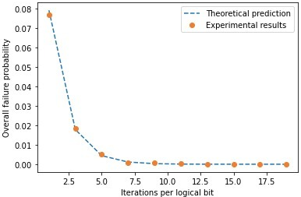
How well does it work?

Slide 19
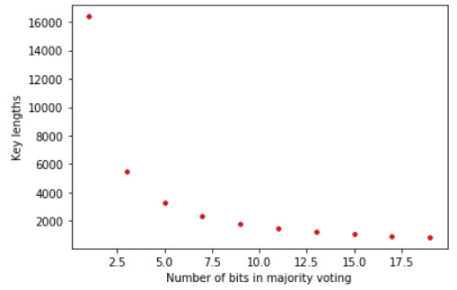
How well does it work?

Slide 20
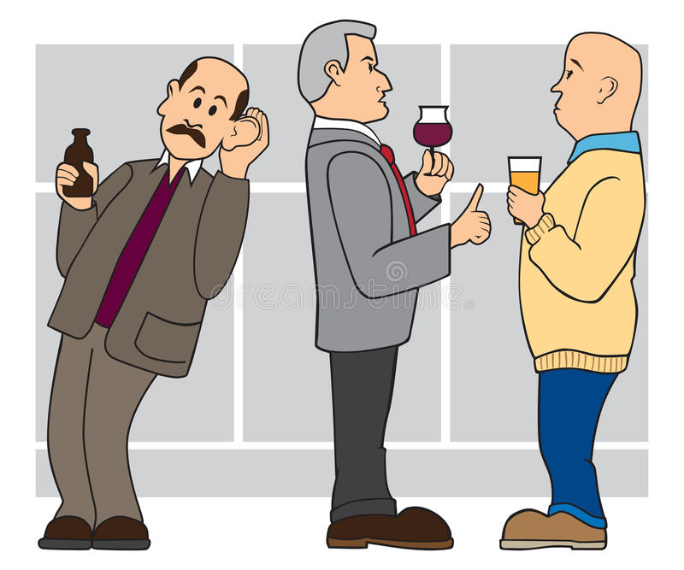
3
Eavesdropper Attack
What happens when an Eavesdropper tries to attack the protocol?
BB84 & E91
Repetition Code
Eavesdropper
Privacy Amplification

Slide 21
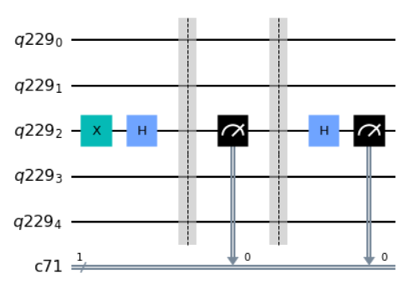
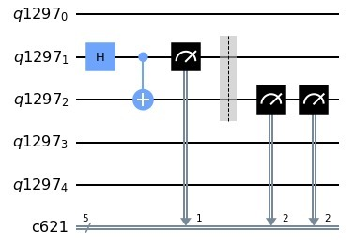
Man in the middle attack
BB84 & E91
Repetition code
Eavesdropper
Privacy Amplification
E91
BB84

Slide 22
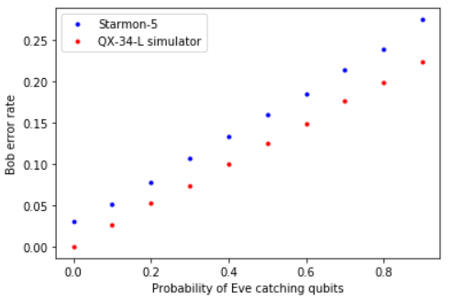
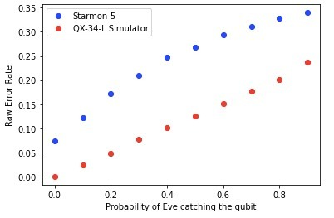
How effective is it?
BB84 & E91
Repetition code
Eavesdropper
Privacy Amplification
E91
BB84

Slide 23
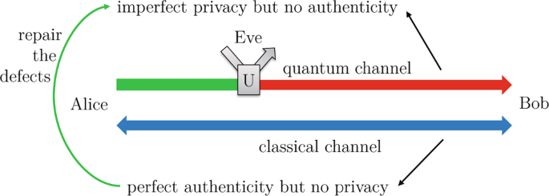
4
Privacy Amplification
Can we still make a ‘safe’ key when Eve is listening?
BB84 & E91
Repetition Code
Eavesdropper
Privacy Amplification

Slide 24
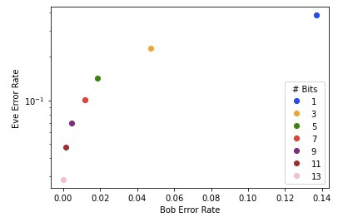
Eve’s and Bob’s error rates
BB84 & E91
Repetition code
Eavesdropper
Privacy Amplification
(On the QX-34-L simulator)

Slide 25
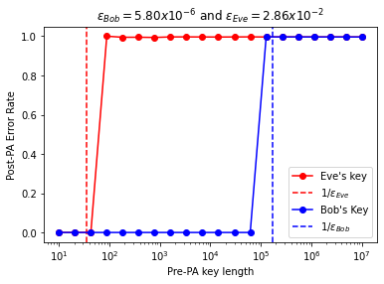
Eve’s and Bob’s error rates
BB84 & E91
Repetition code
Eavesdropper
Privacy Amplification
(On the QX-34-L simulator)

Slide 26
Eve’s and Bob’s error rates
BB84 & E91
Repetition code
Eavesdropper
Privacy Amplification
(On the QX-34-L simulator)

Slide 27
Recap
How many roads must a man walk down before you call him a man?
5
Private
communication?
Alicia Keys
Bob Dylan

Slide 28
Recap
5
How many roads must a man walk down before you call him a man?
Private
communication?
~ 98.6%
Alicia Keys
Bob Dylan
~ 99.3%
~ 96.0%
~ 94.5%
Alice’s bit: 0
Alice’s basis: 0
Bob’s basis: 0
Alice’s bit: 1
Alice’s basis: 0
Bob’s basis: 0
Alice’s bit: 0
Alice’s basis: 1
Bob’s basis: 1
Alice’s bit: 1
Alice’s basis: 1
Bob’s basis: 1

Slide 29
Recap
5
How many roads must a man walk down before you call him a man?
Private
communication?
Alice’s Bits | 0 | 1 | 1 | 1 | 0 | 1 | 0 | 0 | 1 | 1 | 1 | 0 | …
Alice’s Basis | 1 | 0 | 0 | 0 | 1 | 0 | 1 | 1 | 0 | 1 | 0 | 1 | …
Bob’s Basis | 0 | 0 | 0 | 1 | 0 | 0 | 0 | 0 | 0 | 0 | 0 | 0 | …
Bob’s Bits (measured) | 0 | 1 | 1 | 0 | 0 | 0 | 1 | 1 | 1 | 0 | 1 | 1 | …
Alicia Keys
Bob Dylan
?
{2,3,7,10,15}
?
Alice’s Bits | 0 | 1 | 1 | 1 | 0 | 1 | 0 | 0 | 1 | 1 | 1 | 0 | …
Alice’s Basis | 1 | 0 | 0 | 0 | 1 | 0 | 1 | 1 | 0 | 1 | 0 | 1 | …
Bob’s Basis | 0 | 0 | 0 | 1 | 0 | 0 | 0 | 0 | 0 | 0 | 0 | 0 | …
Bob’s Bits (measured) | 0 | 1 | 1 | 0 | 0 | 0 | 1 | 1 | 1 | 0 | 1 | 1 | …

Slide 30
Recap
5
How many roads must a man walk down before you call him a man?
Private
communication?
Alicia Keys
Bob Dylan
Alice’s Bits | 0 | 1 | 1 | 1 | 0 | 1 | 0 | 0 | 1 | 1 | 1 | 0 | …
Alice’s Basis | 1 | 0 | 0 | 0 | 1 | 0 | 1 | 1 | 0 | 1 | 0 | 1 | …
Bob’s Basis | 0 | 0 | 0 | 1 | 0 | 0 | 0 | 0 | 0 | 0 | 0 | 0 | …
Bob’s Bits (measured) | 0 | 1 | 1 | 0 | 0 | 0 | 1 | 1 | 1 | 0 | 1 | 1 | …

Slide 31
Questions?

Slide 32
References
QuTech. (2020) Quantum Inspire Starmon-5 Fact Sheet. https://qutech.nl/wp-content/uploads/2020/04/3.-Technical-Fact-Sheet-Quantum-Inspire-Starmon-5.pdf

